Slide 1
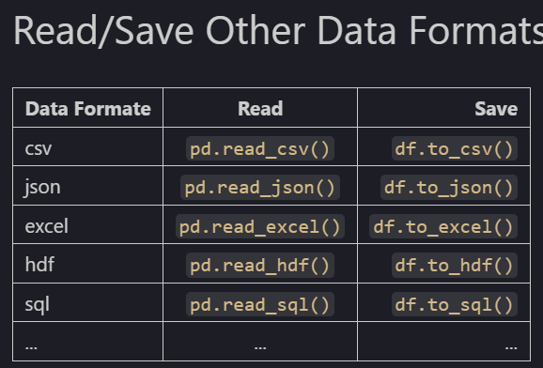
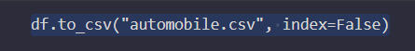
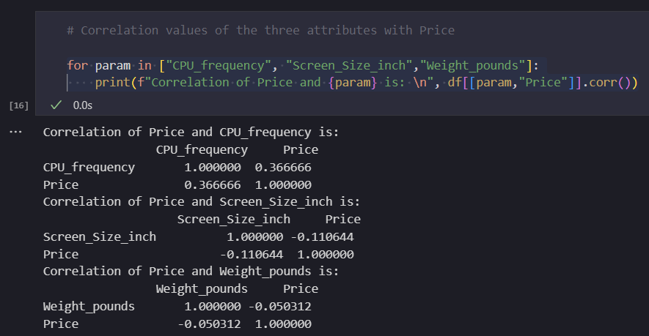
github.com/cmawer/pycon-2017-eda-tutorial/blob/master/EDA-cheat-sheet.md

Slide 2
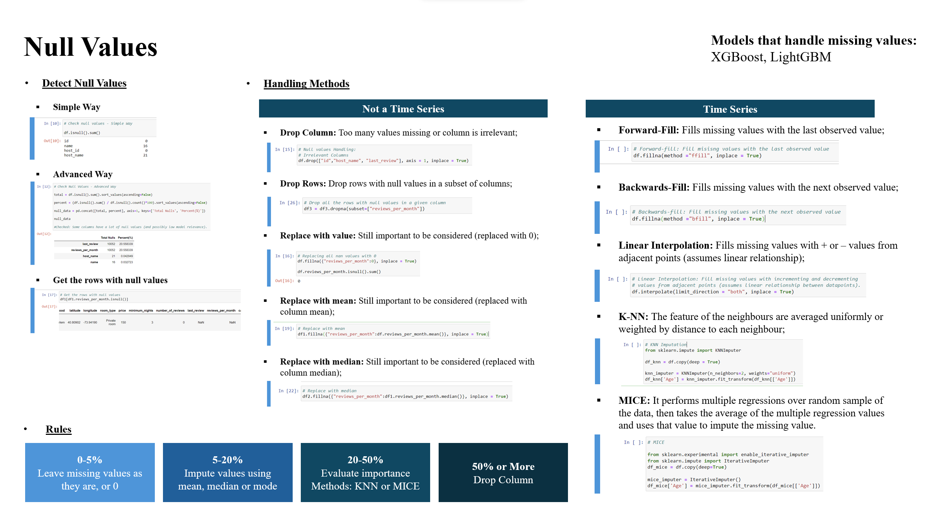
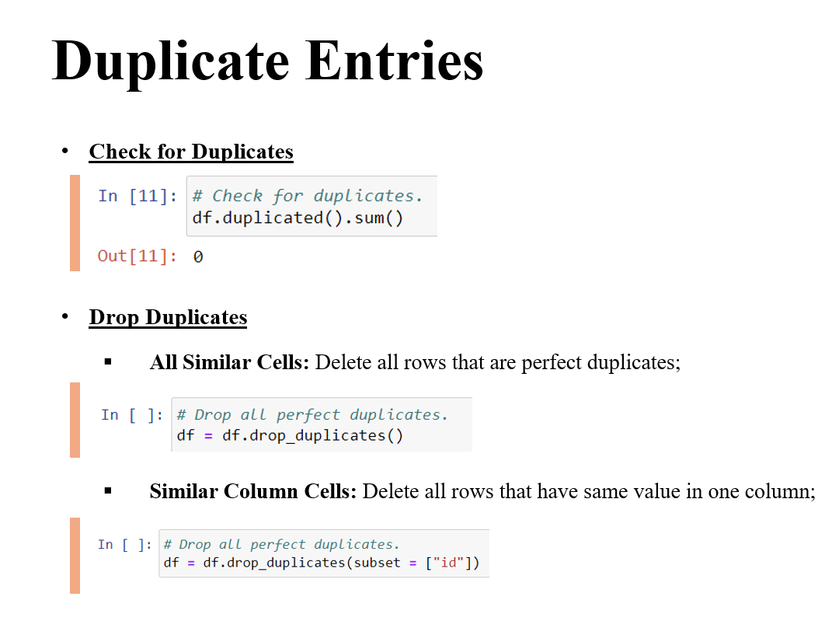
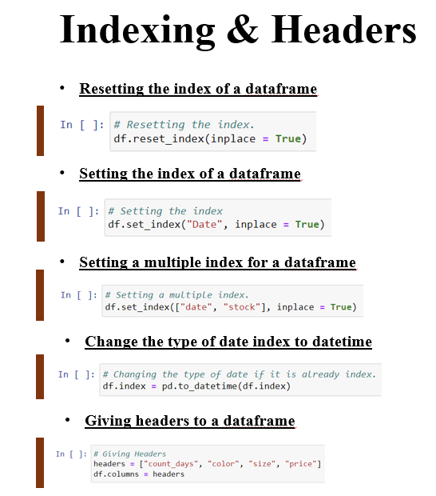
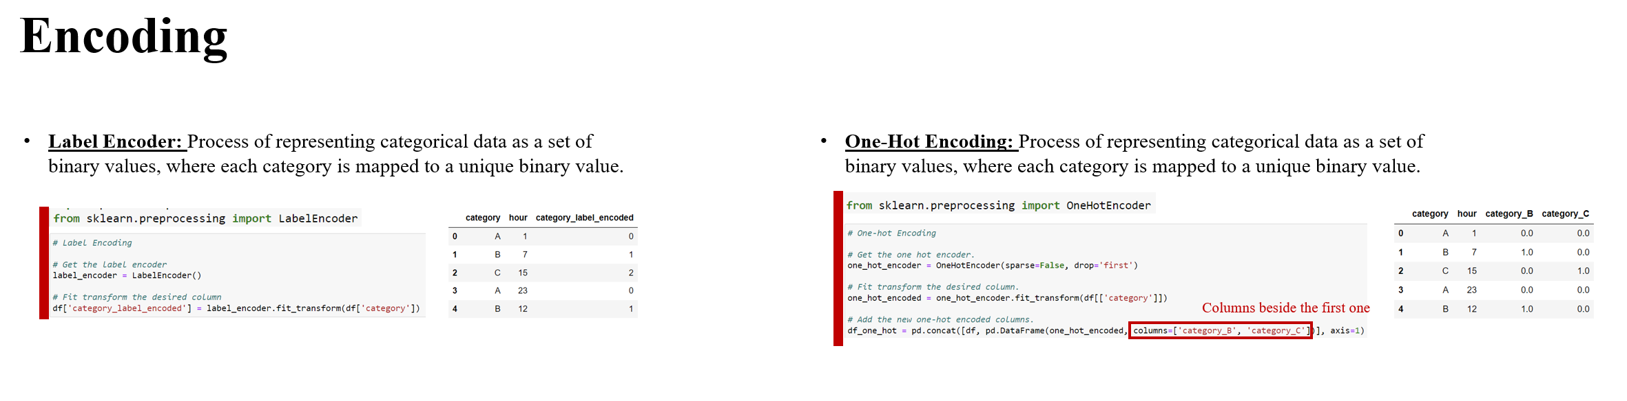
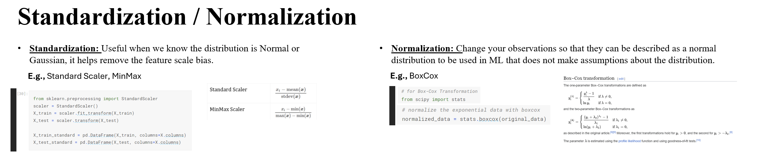
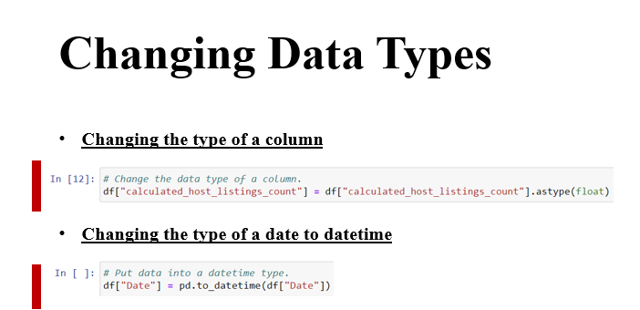
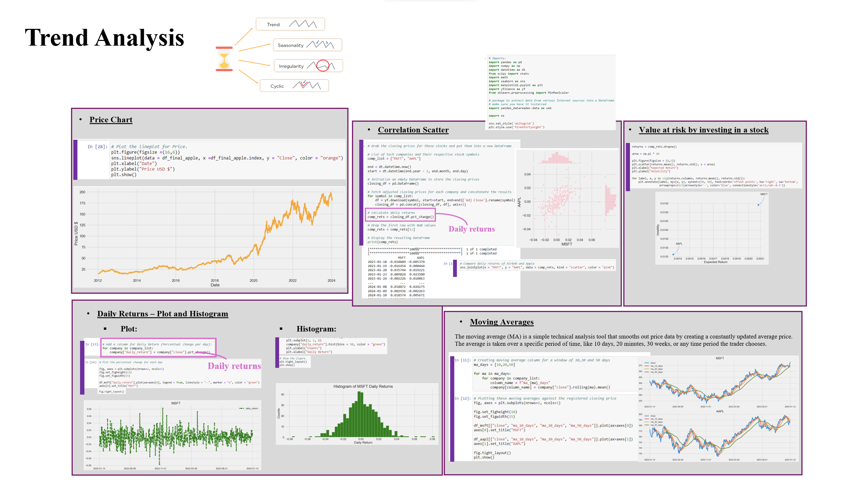
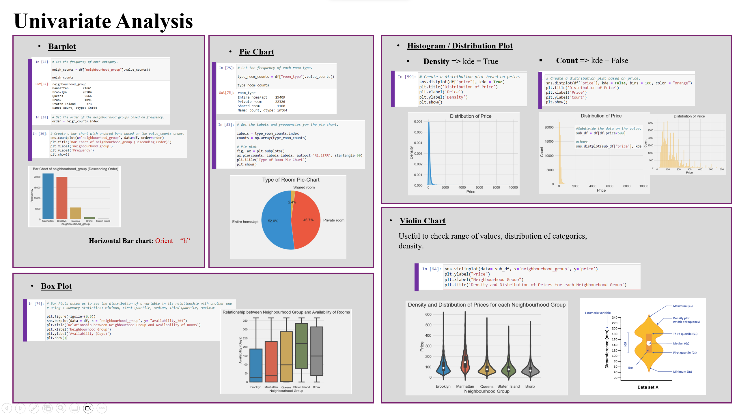
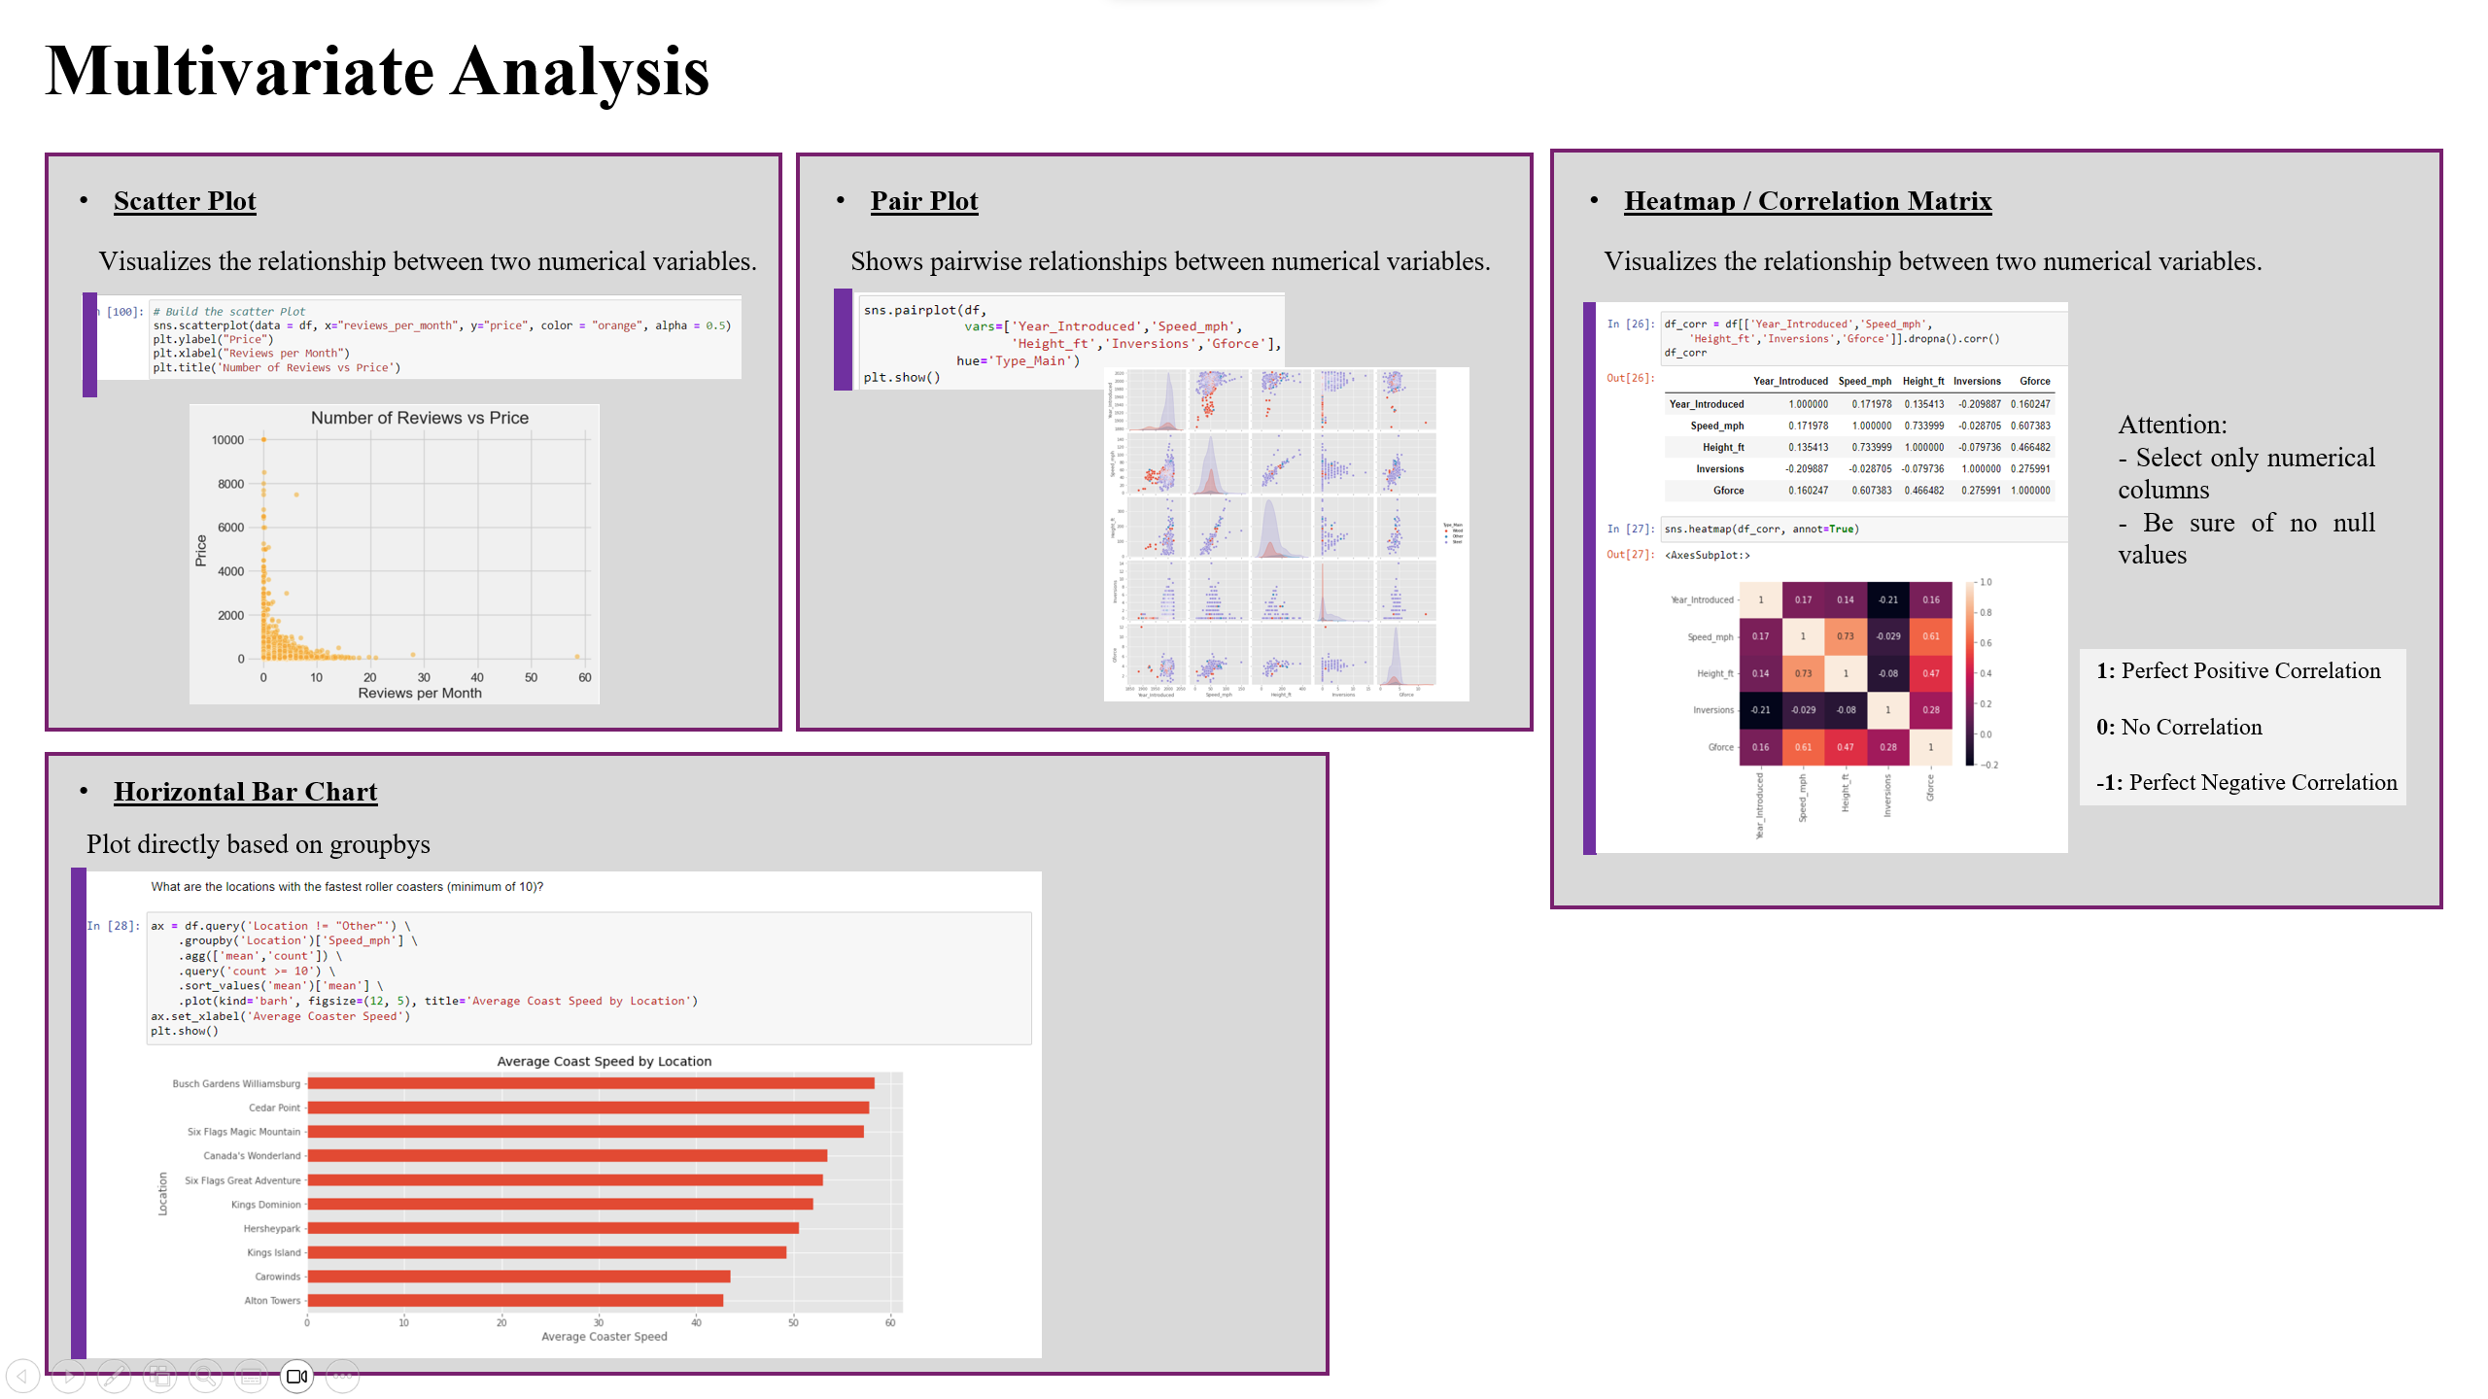
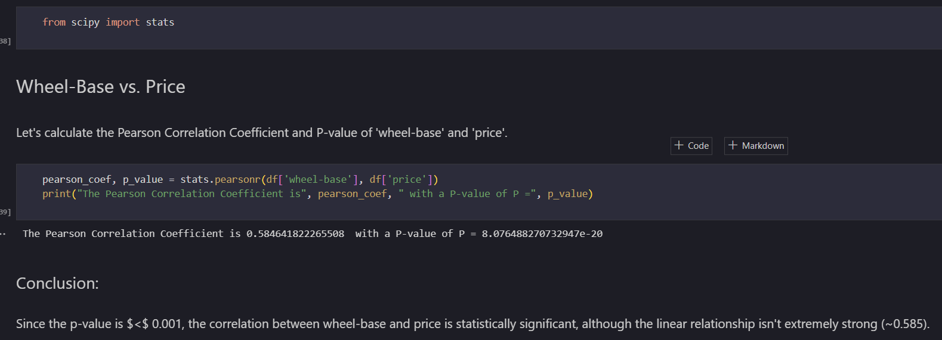
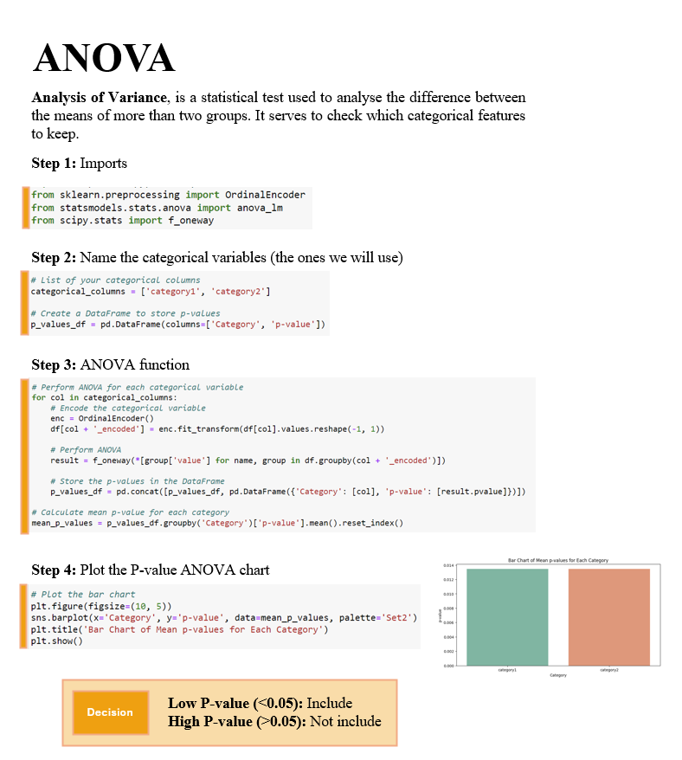
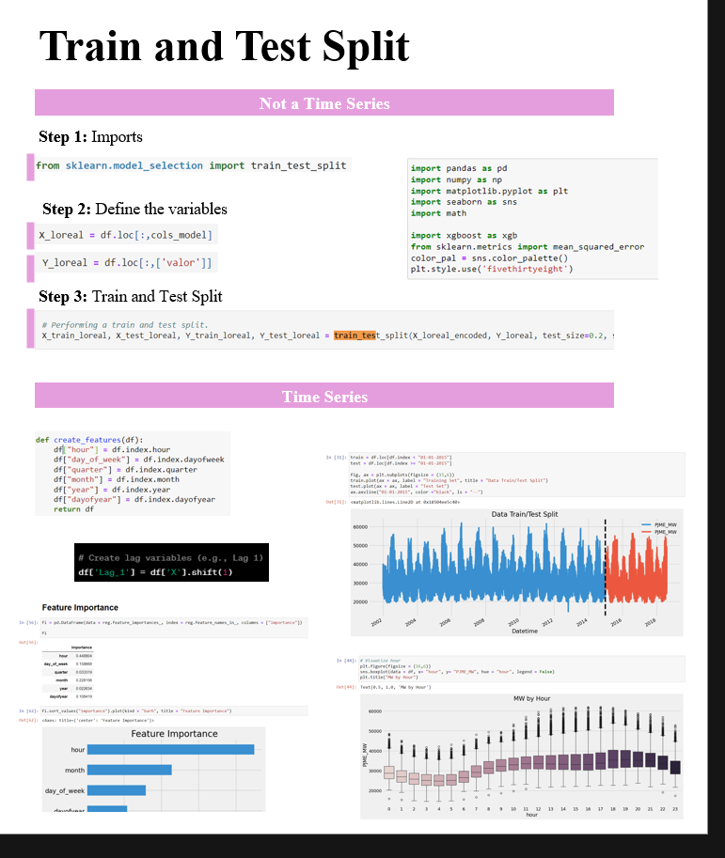
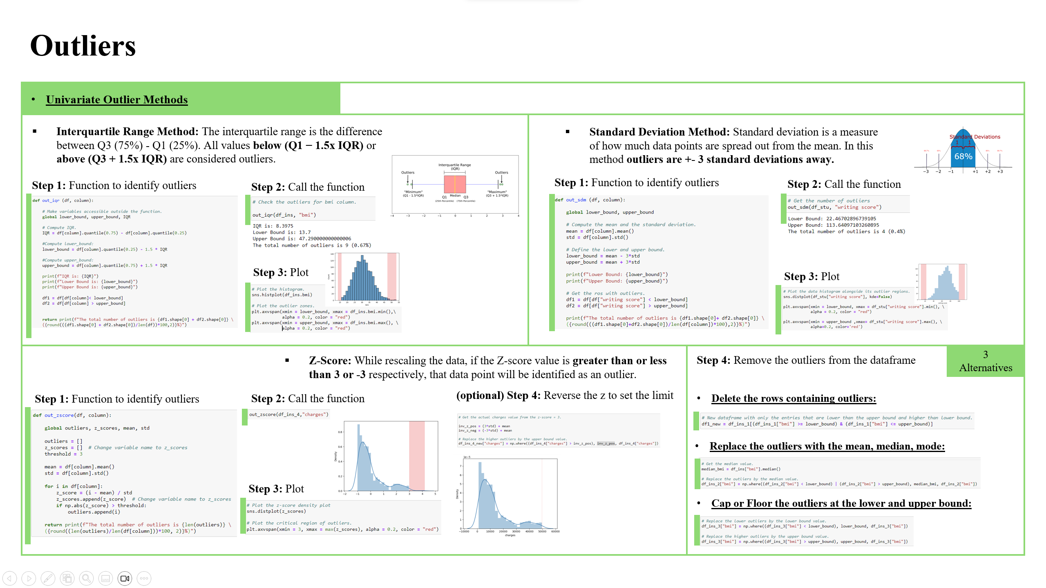
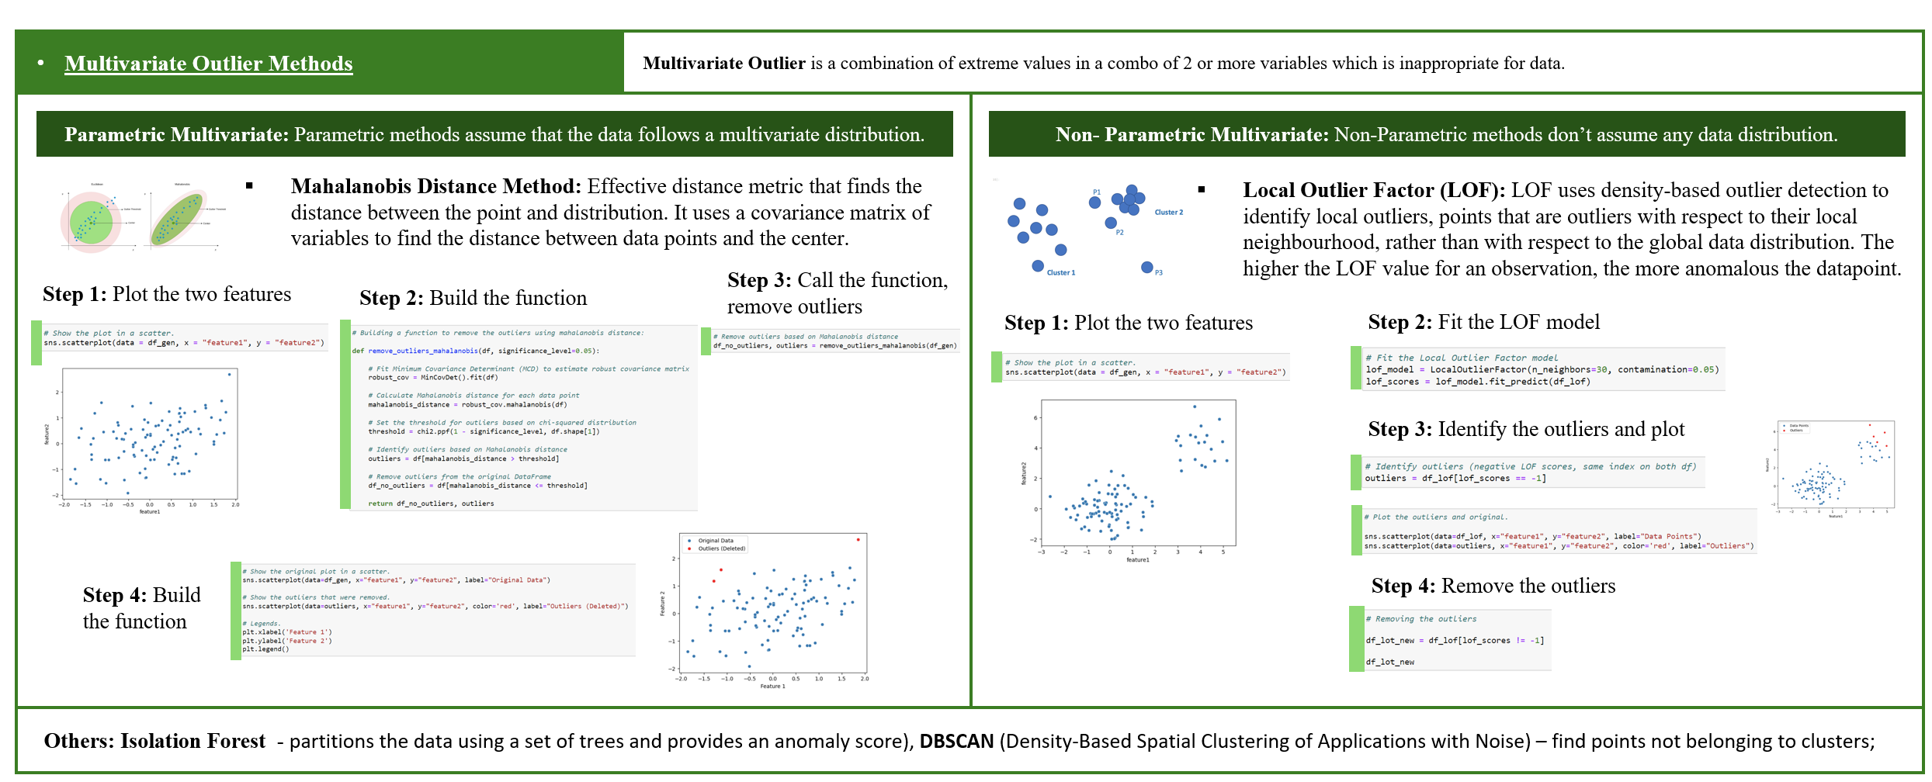

Slide 3
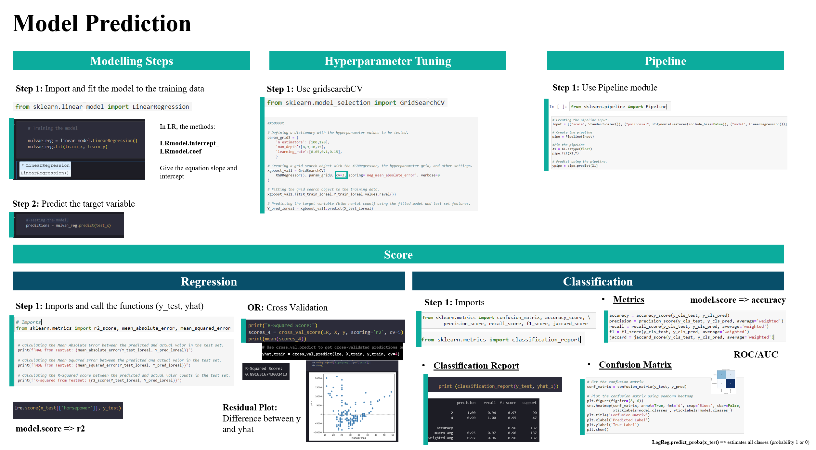
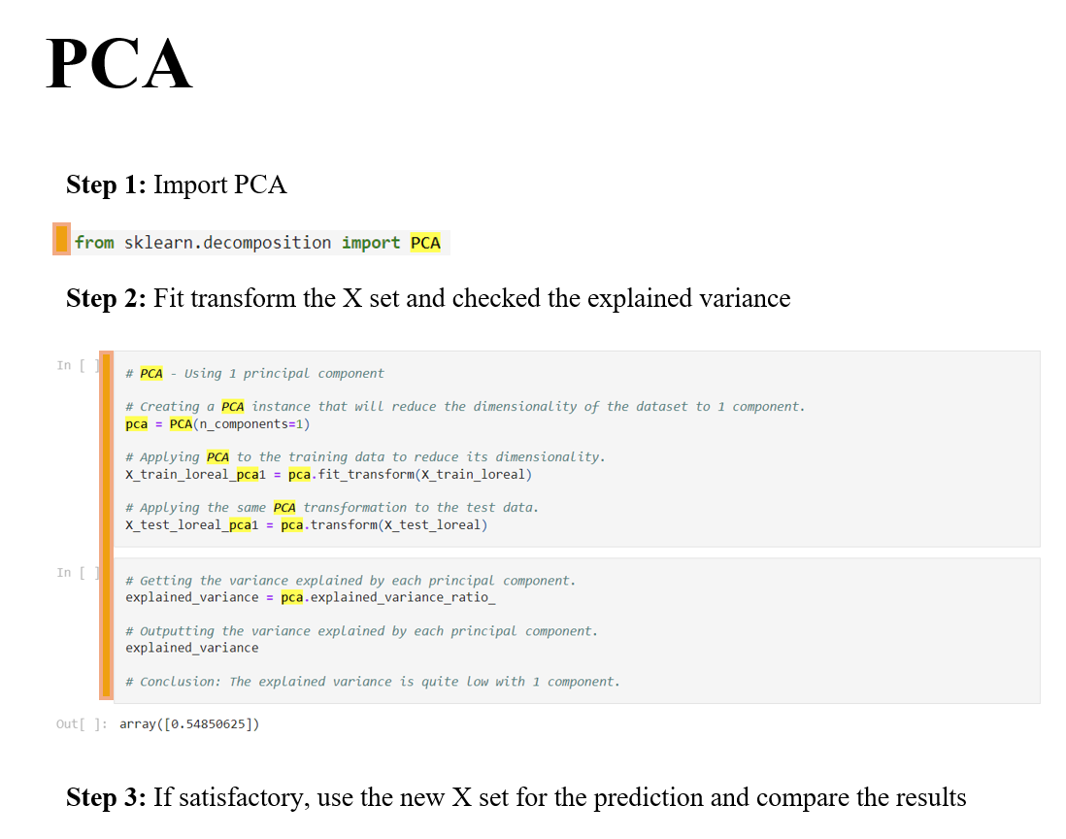
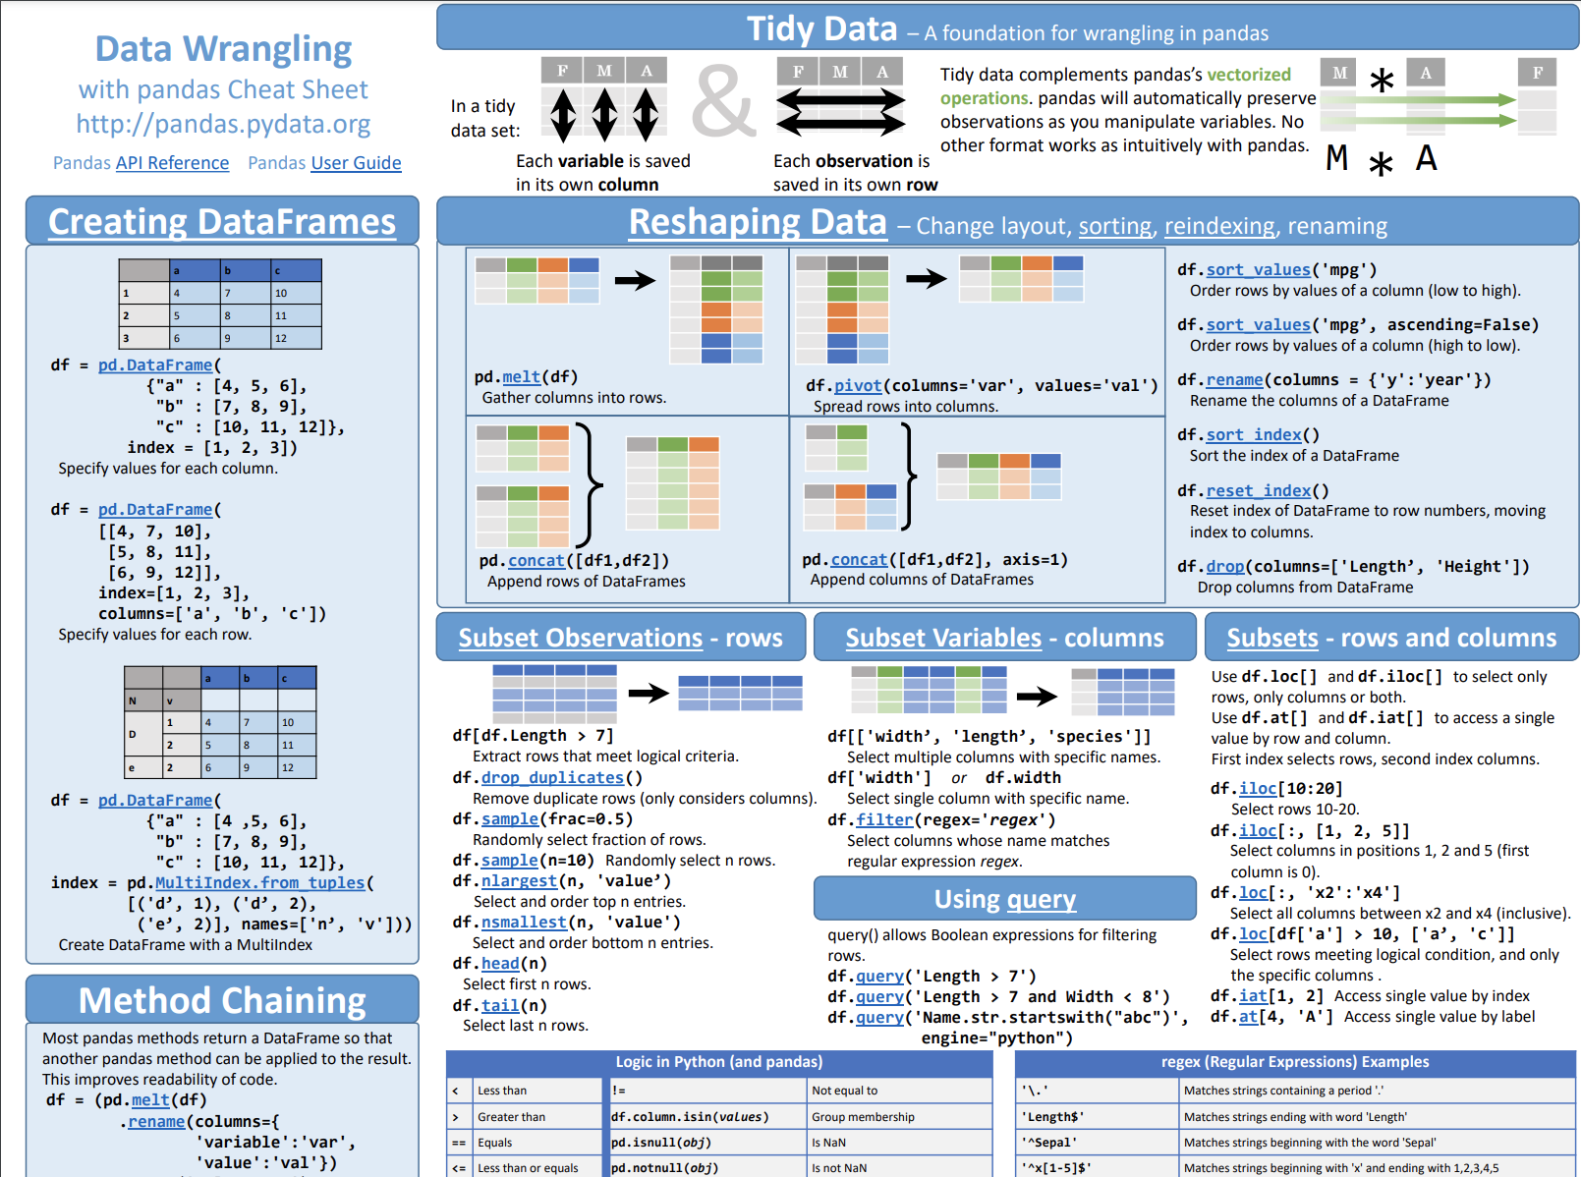
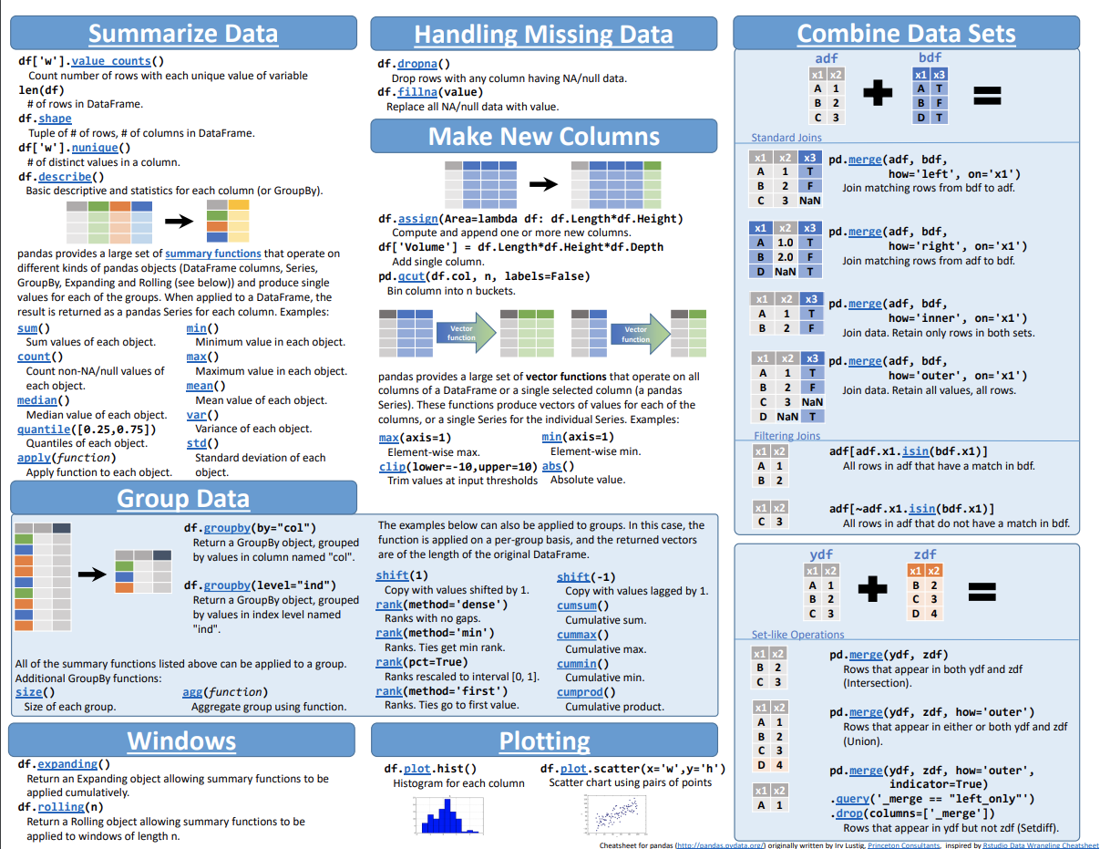

Slide 4
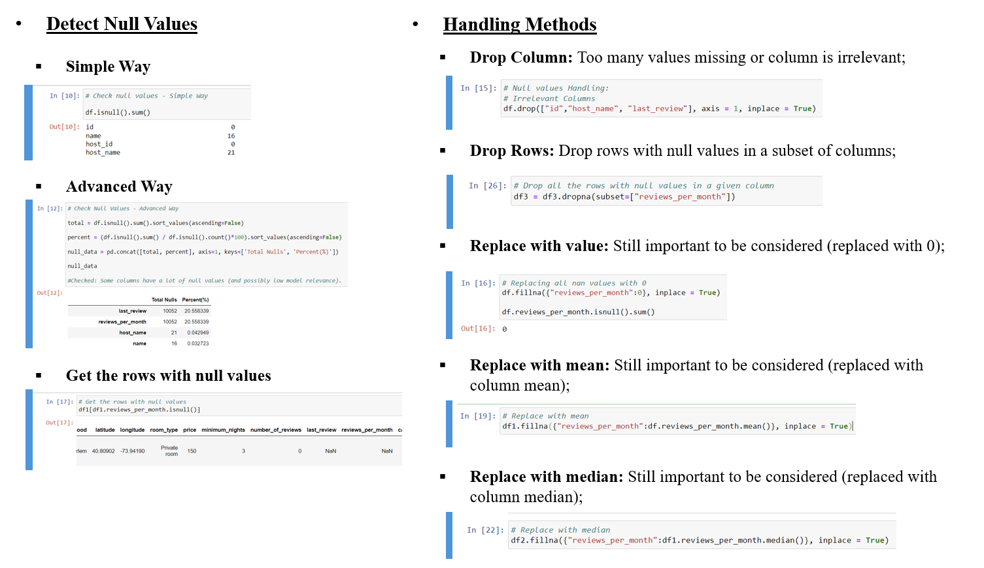
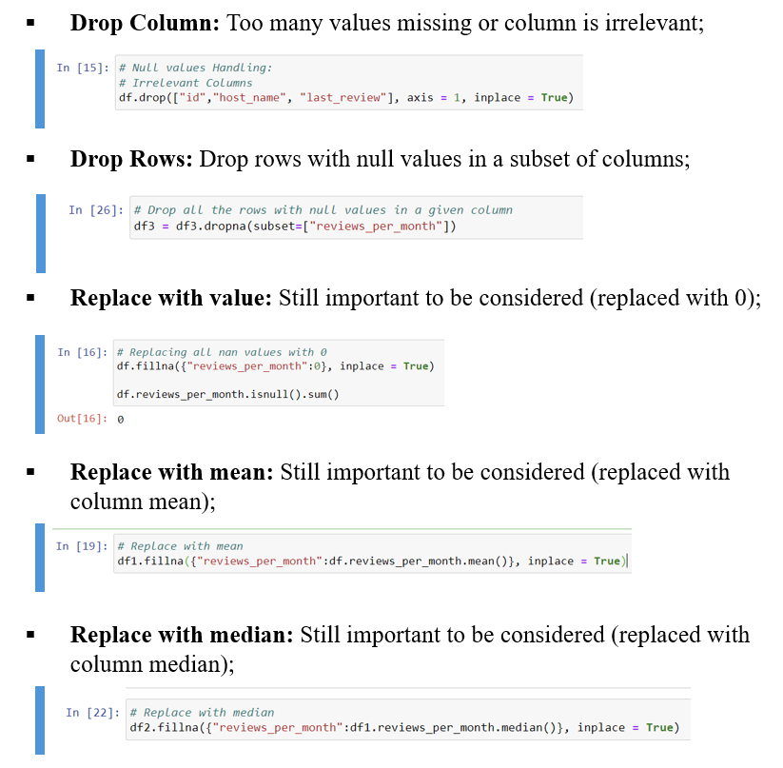
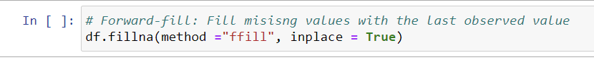
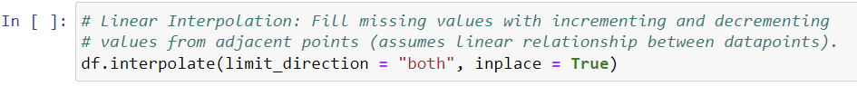
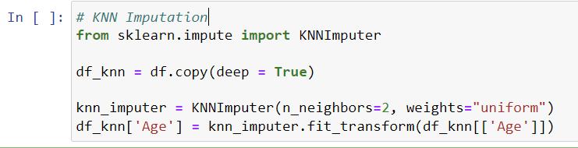
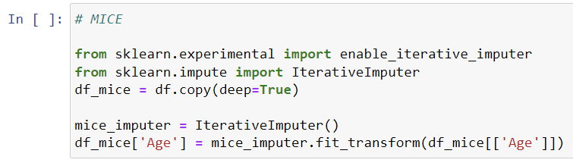
Null Values
Models that handle missing values:
XGBoost, LightGBM
Not a Time Series
Time Series
Forward-Fill: Fills missing values with the last observed value;
Backwards-Fill: Fills missing values with the next observed value;
Linear Interpolation: Fills missing values with + or – values from adjacent points (assumes linear relationship);
K-NN: The feature of the neighbours are averaged uniformly or weighted by distance to each neighbour;
MICE: It performs multiple regressions over random sample of the data, then takes the average of the multiple regression values and uses that value to impute the missing value.
Rules
0-5%
Leave missing values as they are, or 0
5-20%
Impute values using mean, median or mode
20-50%
Evaluate importance
Methods: KNN or MICE
50% or More
Drop Column

Slide 5
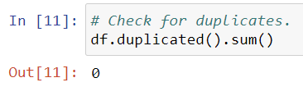
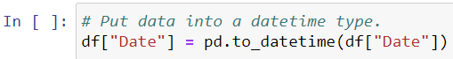
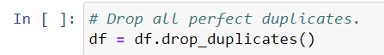
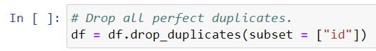
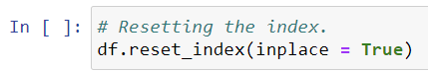
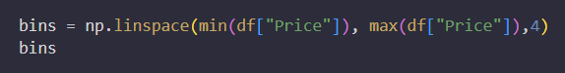
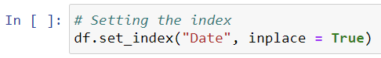
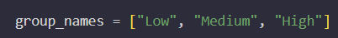
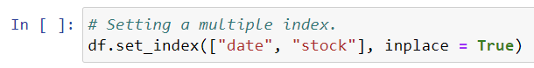
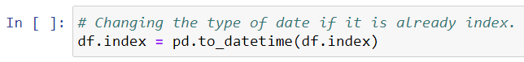
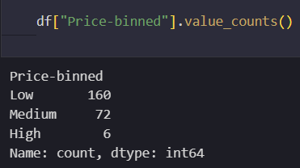
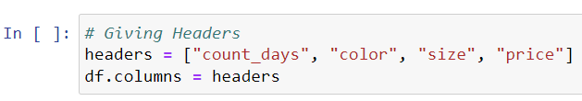
Duplicate Entries
Changing Data Types
Check for Duplicates
Changing the type of a column
Drop Duplicates
Changing the type of a date to datetime
All Similar Cells: Delete all rows that are perfect duplicates;
Indexing & Headers
Similar Column Cells: Delete all rows that have same value in one column;
Resetting the index of a dataframe
Bins
Setting the index of a dataframe
Step 1: Create the bins
Step 2: Set Group Names
Setting a multiple index for a dataframe
Step 3: Create the column and cut the function
Change the type of date index to datetime
Step 4: Get the value counts
Giving headers to a dataframe

Slide 6
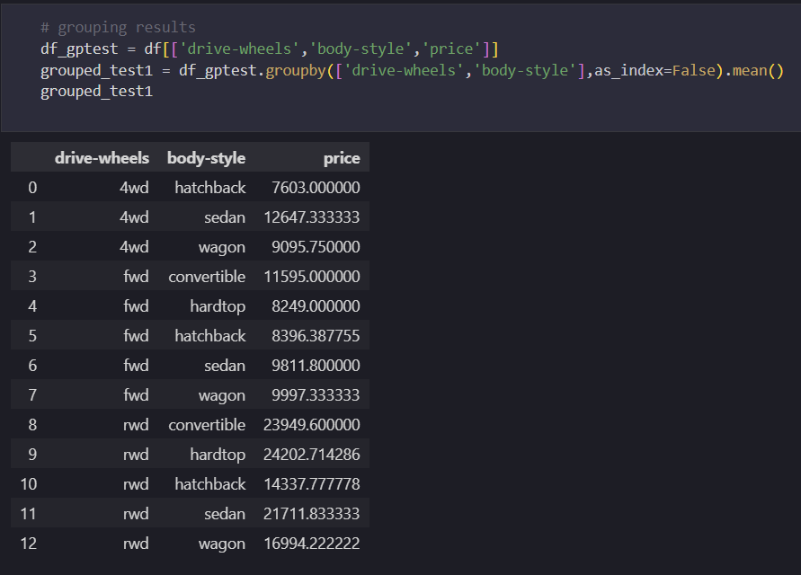
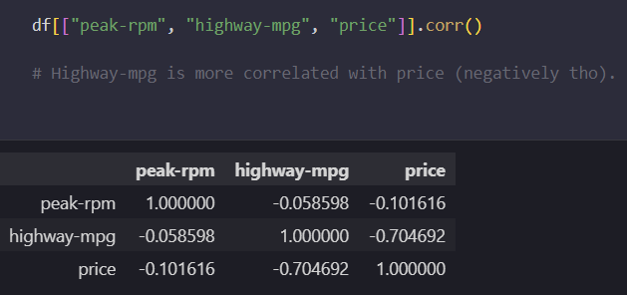
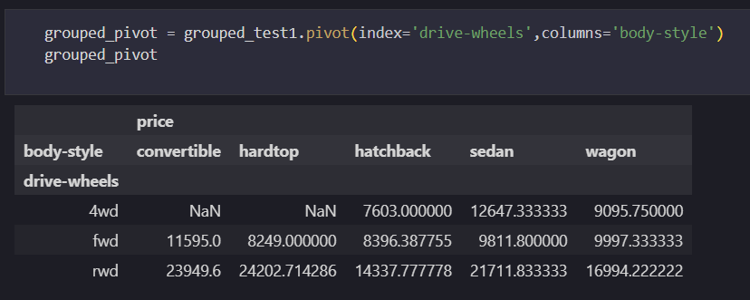
Data Observation
Group By with Operation
Correlation and Causation (Relevancy)
P-value is the probability value that the correlation between these two variables is statistically significant.
Pivot table

Slide 7
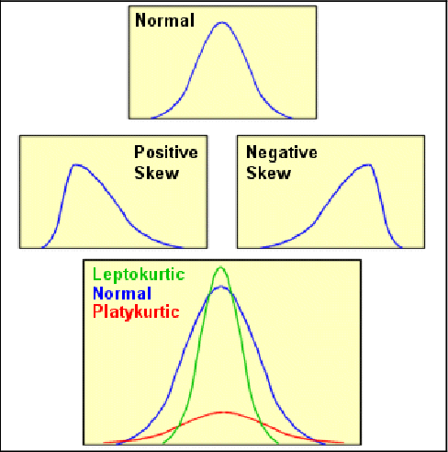
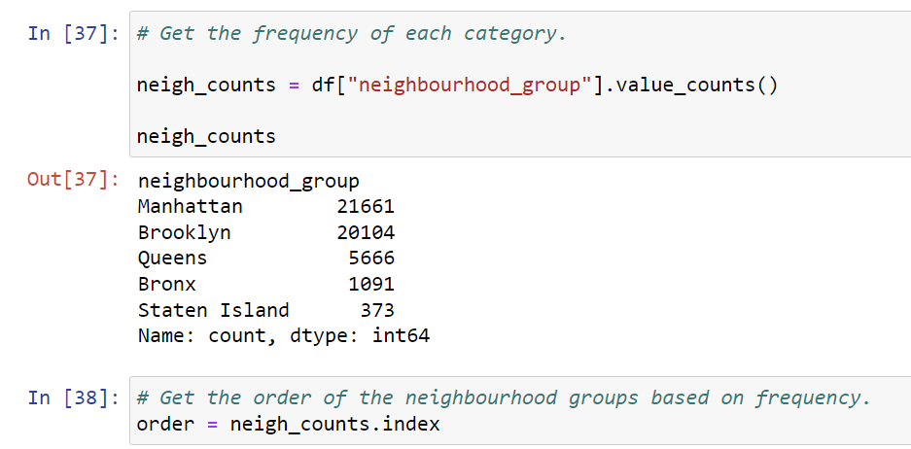
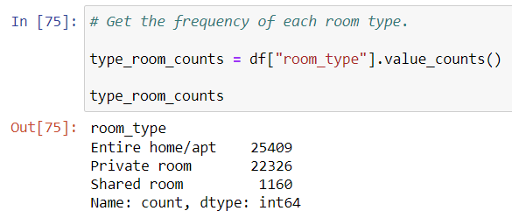
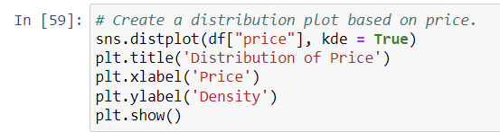
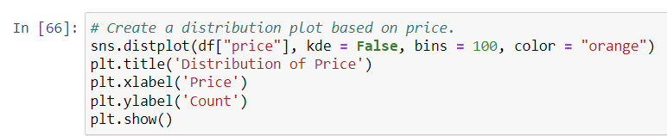
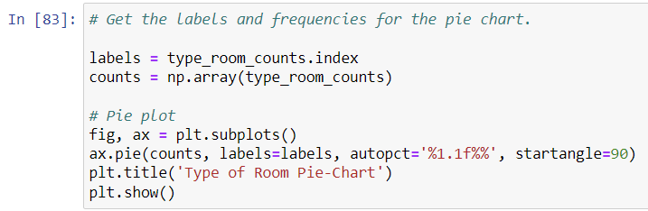
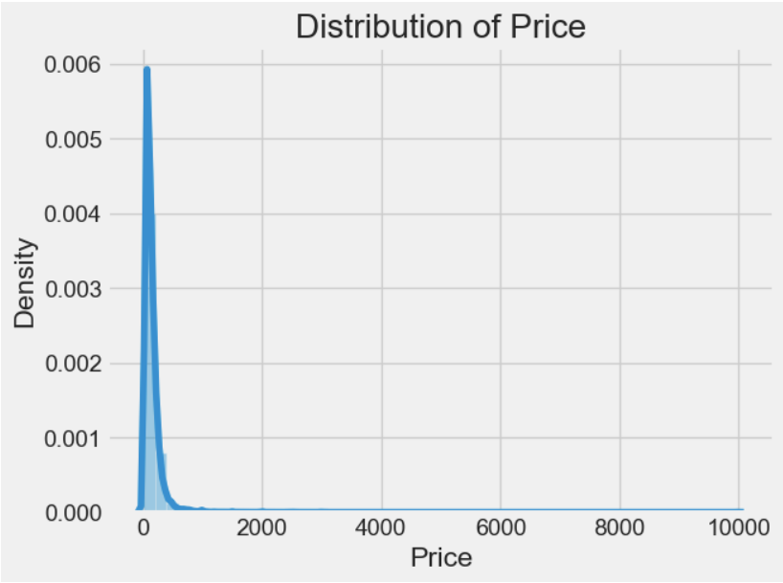
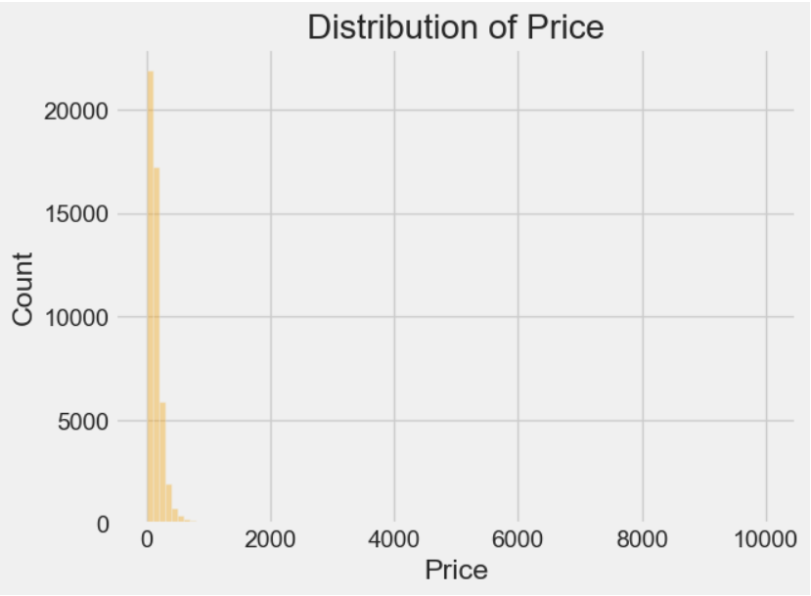









Univariate Analysis
Barplot
Pie Chart
Histogram / Distribution Plot
Density => kde = True
Count => kde = False
Violin Chart
Horizontal Bar chart: Orient = “h”
Useful to check range of values, distribution of categories, density.
Box Plot

Slide 8






Multivariate Analysis
Scatter Plot
Pair Plot
Heatmap / Correlation Matrix
Visualizes the relationship between two numerical variables.
Shows pairwise relationships between numerical variables.
Visualizes the relationship between two numerical variables.
Attention:
- Select only numerical columns
- Be sure of no null values
1: Perfect Positive Correlation
0: No Correlation
-1: Perfect Negative Correlation
Horizontal Bar Chart
Plot directly based on groupbys

Slide 9



Trend Analysis
Daily returns

Slide 10


















Outliers
Univariate Outlier Methods
Interquartile Range Method: The interquartile range is the difference between Q3 (75%) - Q1 (25%). All values below (Q1 − 1.5x IQR) or above (Q3 + 1.5x IQR) are considered outliers.
Standard Deviation Method: Standard deviation is a measure of how much data points are spread out from the mean. In this method outliers are +- 3 standard deviations away.
Step 1: Function to identify outliers
Step 2: Call the function
Step 1: Function to identify outliers
Step 2: Call the function
Step 3: Plot
Step 3: Plot
Z-Score: While rescaling the data, if the Z-score value is greater than or less than 3 or -3 respectively, that data point will be identified as an outlier.
Step 4: Remove the outliers from the dataframe
3 Alternatives
Step 1: Function to identify outliers
Step 2: Call the function
(optional) Step 4: Reverse the z to set the limit
Delete the rows containing outliers:
Replace the outliers with the mean, median, mode:
Step 3: Plot
Cap or Floor the outliers at the lower and upper bound:

Slide 11














Outliers
Multivariate Outlier Methods
Univariate Outlier Methods
Multivariate Outlier is a combination of extreme values in a combo of 2 or more variables which is inappropriate for data.
Parametric Multivariate: Parametric methods assume that the data follows a multivariate distribution.
Non- Parametric Multivariate: Non-Parametric methods don’t assume any data distribution.
Mahalanobis Distance Method: Effective distance metric that finds the distance between the point and distribution. It uses a covariance matrix of variables to find the distance between data points and the center.
Local Outlier Factor (LOF): LOF uses density-based outlier detection to identify local outliers, points that are outliers with respect to their local neighbourhood, rather than with respect to the global data distribution. The higher the LOF value for an observation, the more anomalous the datapoint.
Step 1: Plot the two features
Step 2: Build the function
Step 3: Call the function, remove outliers
Step 1: Plot the two features
Step 2: Fit the LOF model
Step 3: Identify the outliers and plot
Step 4: Build the function
Step 4: Remove the outliers
Others: Isolation Forest - partitions the data using a set of trees and provides an anomaly score), DBSCAN (Density-Based Spatial Clustering of Applications with Noise) – find points not belonging to clusters;

Slide 12









Encoding
Label Encoder: Process of representing categorical data as a set of binary values, where each category is mapped to a unique binary value.
One-Hot Encoding: Process of representing categorical data as a set of binary values, where each category is mapped to a unique binary value.
Columns beside the first one
Standardization / Normalization
Standardization: Useful when we know the distribution is Normal or Gaussian, it helps remove the feature scale bias.
Normalization: Change your observations so that they can be described as a normal distribution to be used in ML that does not make assumptions about the distribution.
E.g., Standard Scaler, MinMax
E.g., BoxCox

Slide 13













ANOVA
Train and Test Split
Analysis of Variance, is a statistical test used to analyse the difference between the means of more than two groups. It serves to check which categorical features to keep.
Not a Time Series
Step 1: Imports
Step 1: Imports
Step 2: Define the variables
Step 2: Name the categorical variables (the ones we will use)
Step 3: Train and Test Split
Step 3: ANOVA function
Time Series
Step 4: Plot the P-value ANOVA chart
Decision
Low P-value (<0.05): Include
High P-value (>0.05): Not include

Slide 14
















Model Prediction
Modelling Steps
Hyperparameter Tuning
Pipeline
Step 1: Import and fit the model to the training data
Step 1: Use gridsearchCV
Step 1: Use Pipeline module
In LR, the methods:
LRmodel.intercept_
LRmodel.coef_
Give the equation slope and intercept
Step 2: Predict the target variable
Score
Regression
Classification
Step 1: Imports and call the functions (y_test, yhat)
OR: Cross Validation
Step 1: Imports
Metrics
model.score => accuracy
ROC/AUC
Classification Report
Confusion Matrix
Residual Plot: Difference between y and yhat
model.score => r2
LogReg.predict_proba(x_test) => estimates all classes (probability 1 or 0)

Slide 15

PCA
Step 1: Import PCA
Step 2: Fit transform the X set and checked the explained variance
Step 3: If satisfactory, use the new X set for the prediction and compare the results

